Slide 1




ESTIMATING ETA EARTH: The Fraction of Stars with Earth-sized Planets in the Habitable Zone
Hannah Ambrose Mentor: Dr. Gijs Mulders
Arizona Space Grant Symposium April 14th, 2018

Slide 2
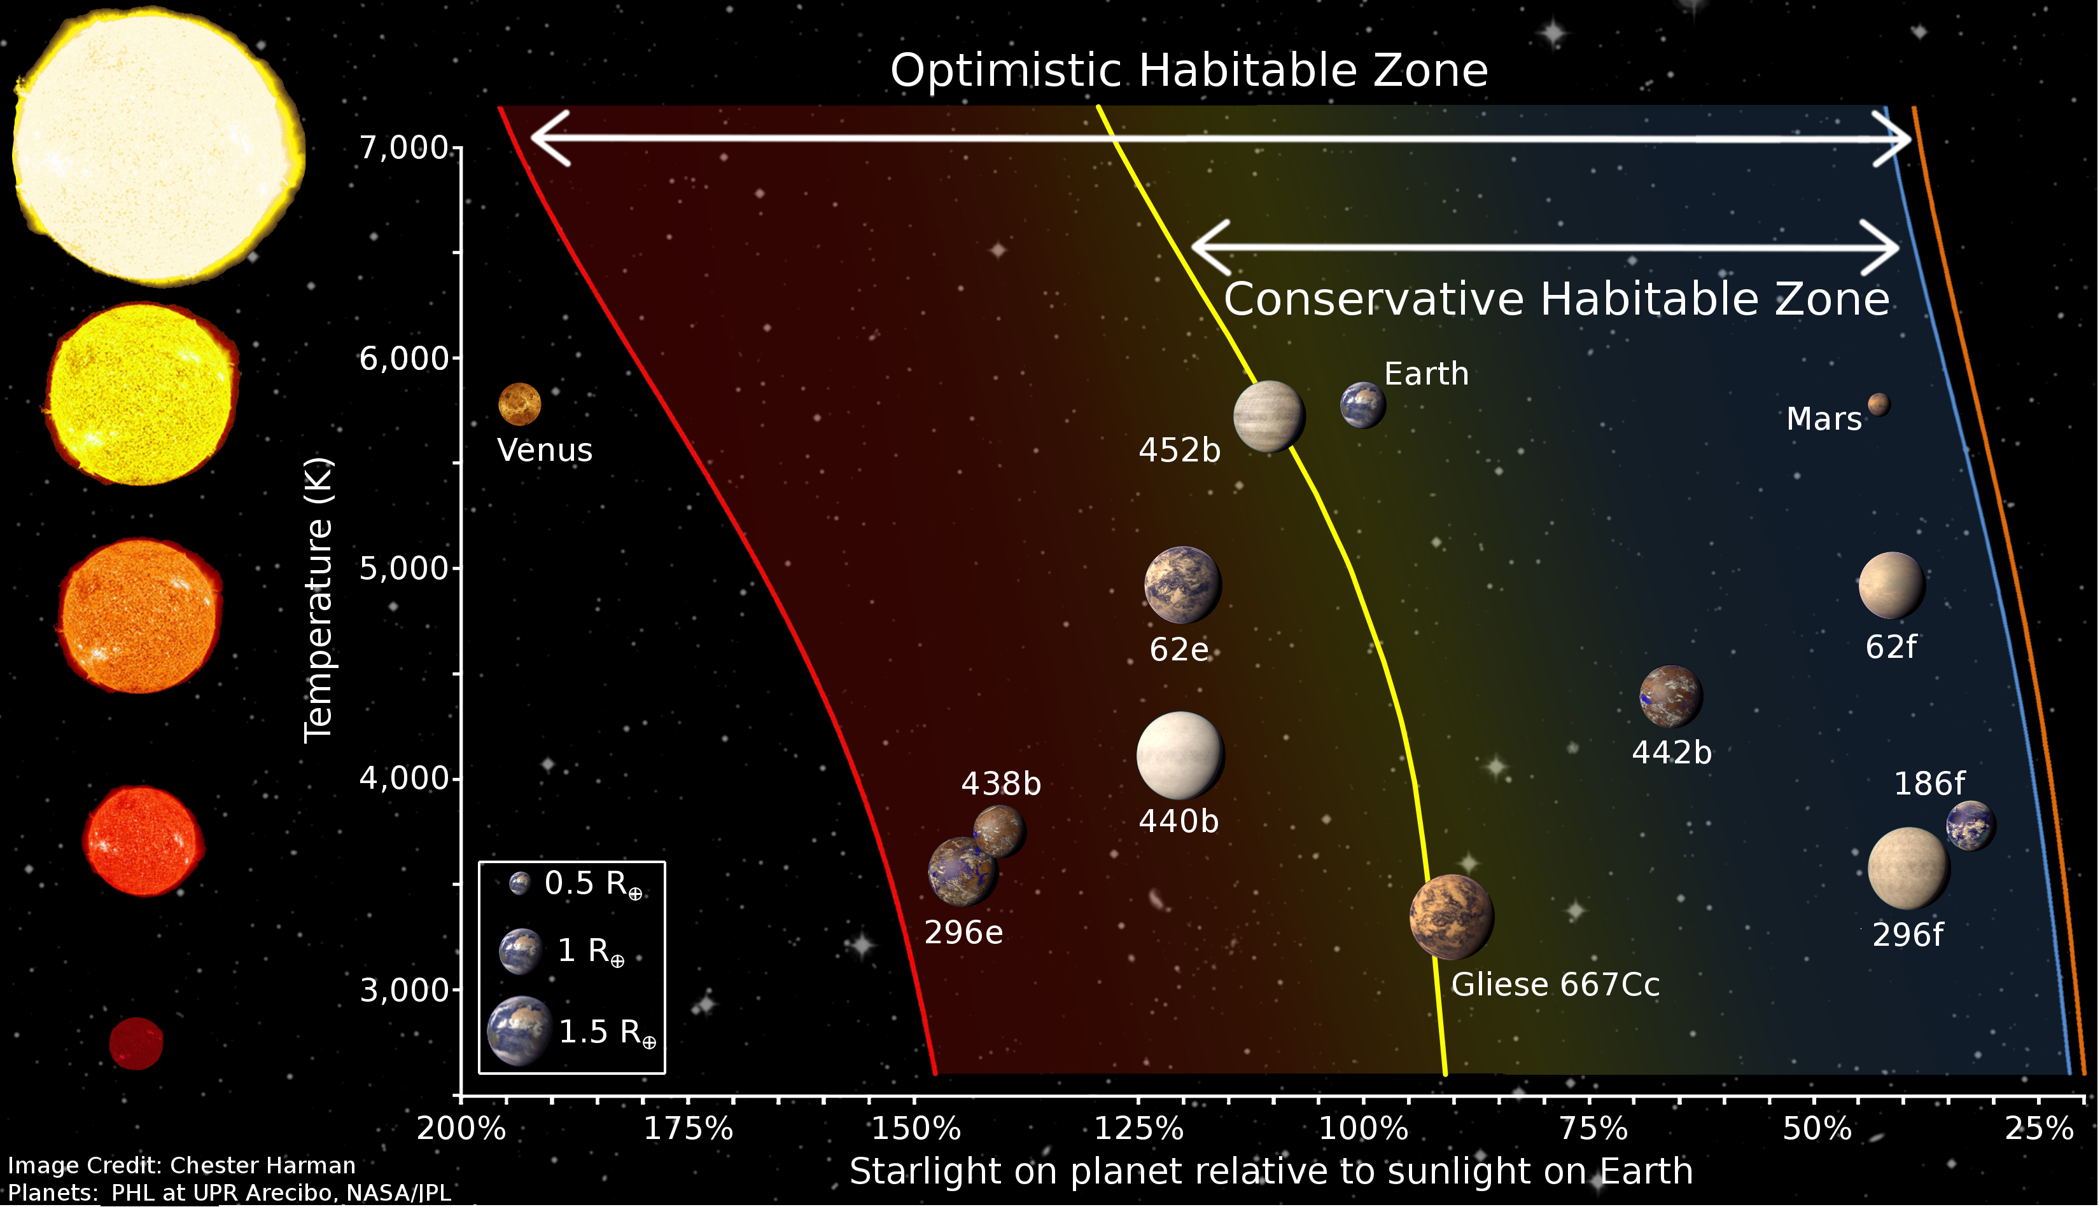

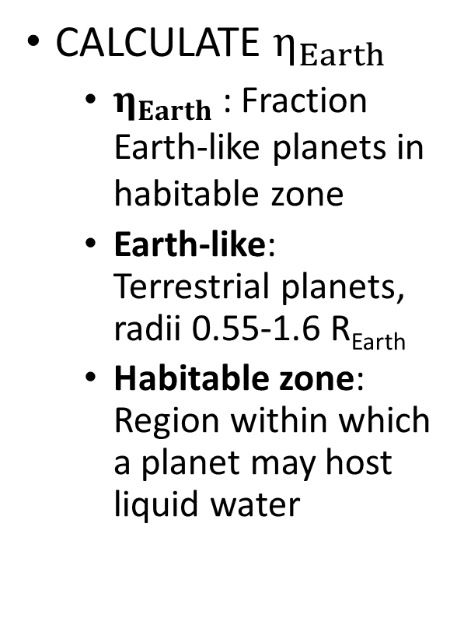
OBJECTIVE
CALCULATE $η_{Earth}$
$η_{Earth}$: Fraction Earth-like planets in habitable zone
Earth-like: Terrestrial planets, radii 0.55-1.6 R_{Earth}
Habitable zone: Region within which a planet may host liquid water

Slide 3
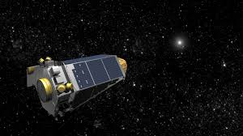
PROCEDURE
Used Kepler DR-25
Collected by Kepler Space Telescope
Most recent release, over 9,000 objects
“Score” value included
“the recommended catalog for estimating planet occurrence rates” –NASA
Image: NASA/JPL

Slide 4
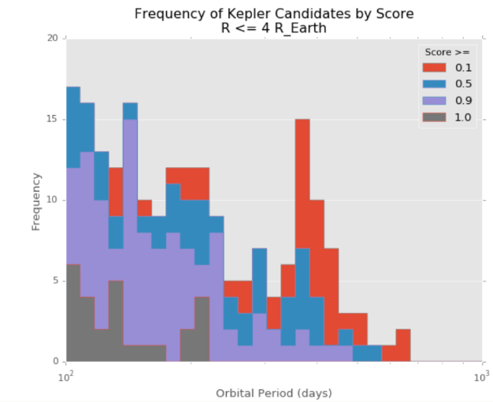
PROCEDURE
Determined score cut-off
Remove false positives
Retain as much data as possible
Peak in low-score objects at ~300 days
Used peak as a flag
Found ideal cut-off of 0.9
300 days
Number of Objects
Orbital Period (days)

Slide 5
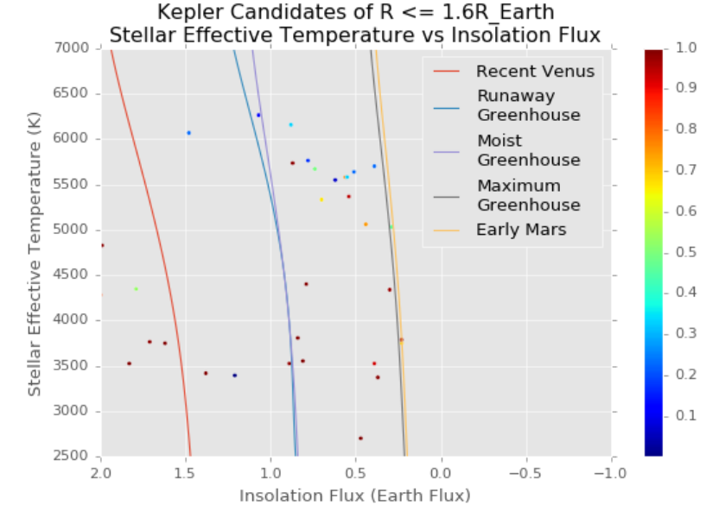
PROCEDURE
Calculated habitable zone
Equations from Kopparapu et. al. 2013
Lines denote inner and outer habitable zone
Chose Runaway Greenhouse and Early Mars lines
Determined exoplanets within lines
Stellar Effective Temperature (K)
Insolation Flux (Earth Flux)

Slide 6
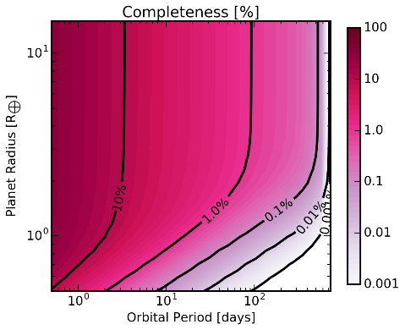
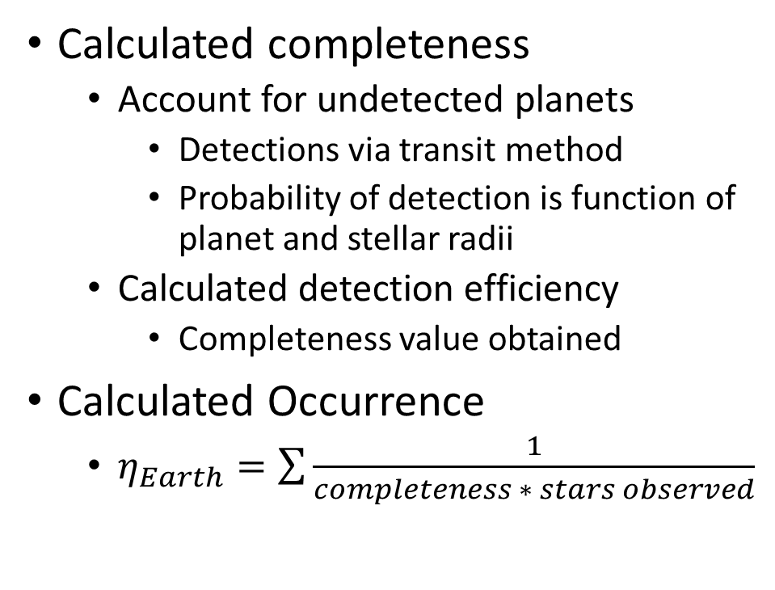
PROCEDURE
Detection Possible Detection Impossible
Calculated completeness
Account for undetected planets
Detections via transit method
Probability of detection is function of planet and stellar radii
Calculated detection efficiency
Completeness value obtained
Calculated Occurrence
$η_{Earth}=\sum{\frac{1}{completeness ∗ stars observed}}$

Slide 7
RESULTS & ANALYSIS
Occurrence results
M stars: 28.5%
K stars: 3.8%
G stars: 7.7%
K, G may be underestimates
Previous Calculations
Dressing and Charbonneau 2015
Petigura et al 2013

Slide 8
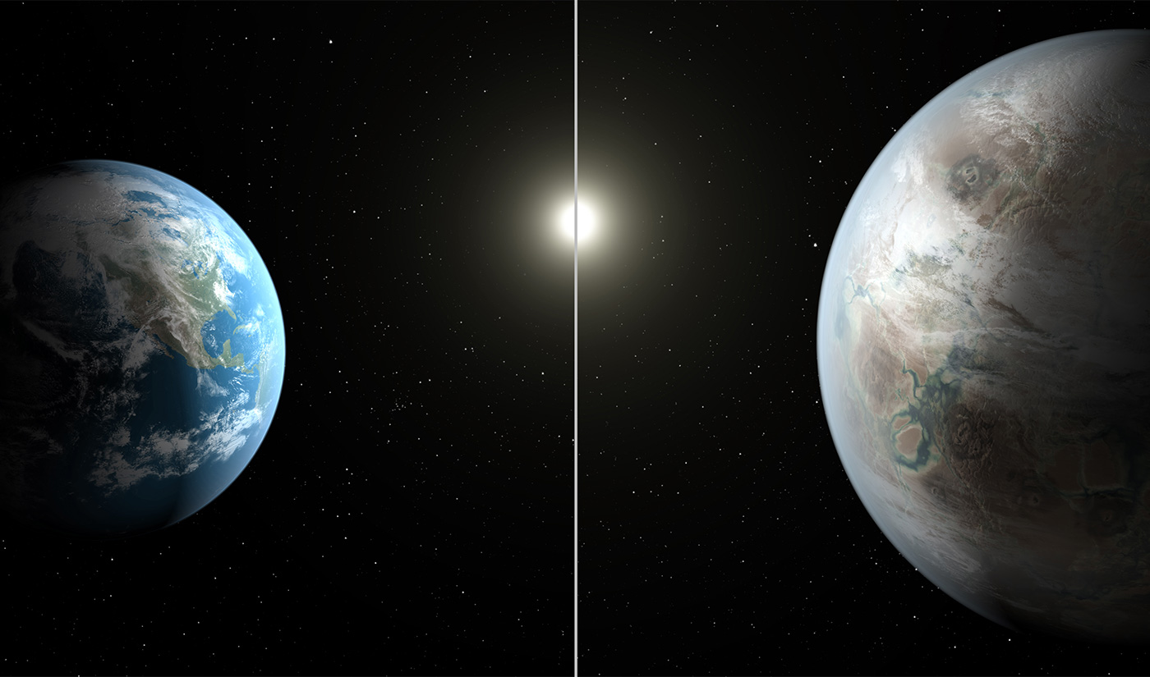
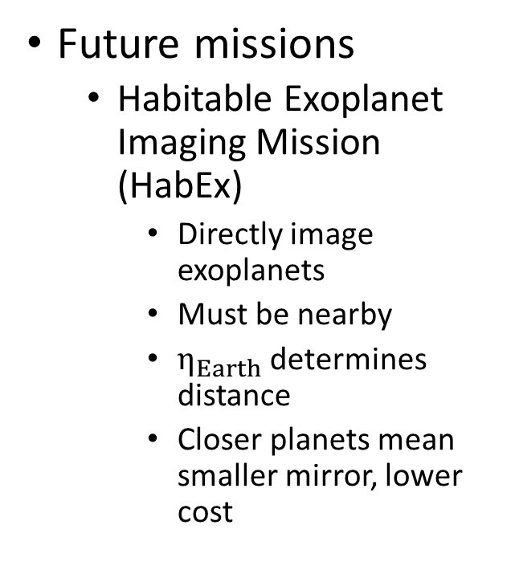
SIGNIFICANCE
Future missions
Habitable Exoplanet Imaging Mission (HabEx)
Directly image exoplanets
Must be nearby
$η_{Earth}$ determines distance
Closer planets mean smaller mirror, lower cost
Image: NASA/JPL

Slide 9
THANK YOU

